Slide 1
W O R K R E W A R D S
How to build a stronger statewide talent pool
1

Slide 2
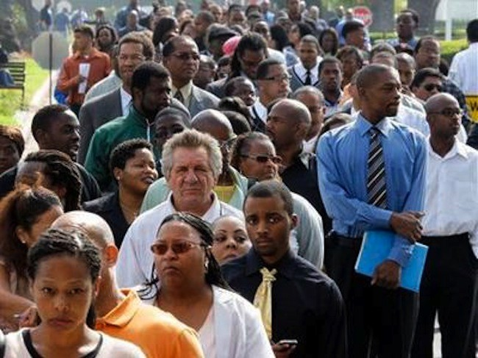
We have difficulty building and maintaining
a skilled and ready labor pool
2

Slide 3
We have multiple issues to address:
Working adults who are not advancing their skills;
Significant business labor needs remain unmet;
Large pockets of unemployment among specific groups; and,
A patchwork of eligibility-based programs.
3

Slide 4
Incumbent worker training
Skills gaps
Unemployment
Work Rewards becomes a single tool to address multiple issues
4

Slide 5
What if pursuing training
and education was the
obvious and easiest choice
for Minnesotans to make?
5

Slide 6
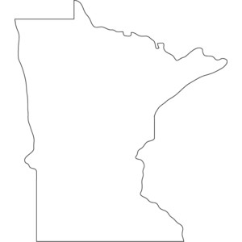
Every Minnesotan with work history participates!
WORK
Rewards
Your Work,
Your Rewards,
O u r F u t u r e
One point earned
for every week worked.
6

Slide 7
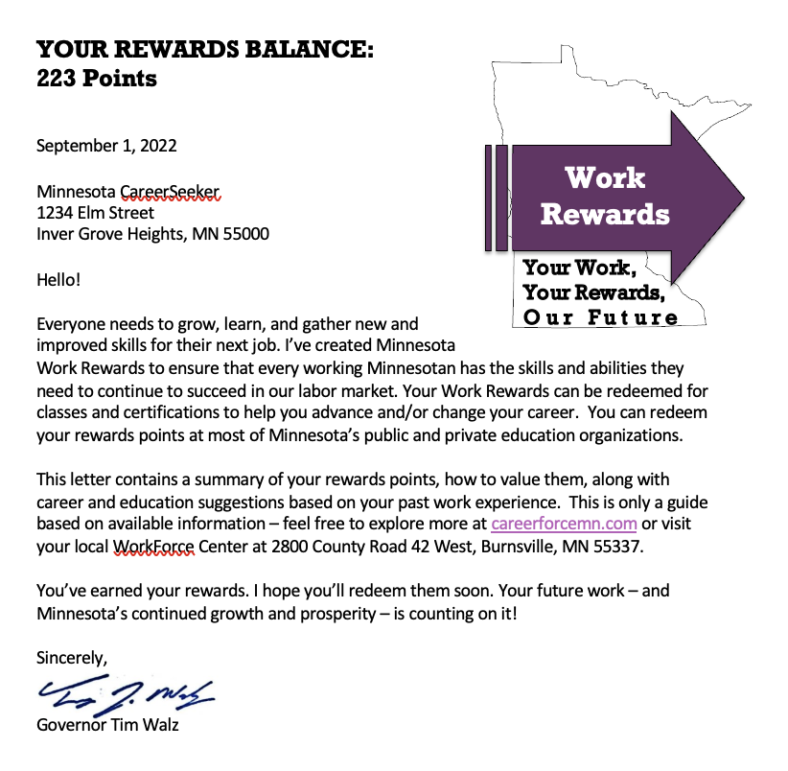
Three times a year, 2.6 Million working Minnesotans would be prompted to upgrade their skills.
7

Slide 8
An invitation to advance your skills...
Through your work, you've earned 258 points in the last five years!
You can redeem those points for additional training in your field; or, consider new work in these high-demand, high-growth occupations...
Your points are redeemable at any Minnesota educational institution.
Giving you something of value based on your work.
8

Slide 9
Work Rewards creates a flexible currency earned through work
Training is paid for by redeeming points; or with combinations of Work Rewards
& other sources.
Work Rewards would pool existing public funds, supplemented by a variety of private and philanthropic sources.
Work Rewards could be valued differentially to address specific labor market needs.
Work Rewards could also be gifted or transferred.
9

Slide 10
Work Rewards addresses multiple issues through a single mechanism
Access: we serve over 200,000 Minnesotans through the public system. About 8,000 (4%) receive staff-assisted services, and only half of those pursue training. Work rewards would open training opportunities to nearly all those served in the public system.
Motivation: we have about 800,000 Minnesotans who have begun some advanced training but never completed it. Work rewards will be understood as leaving "money on the table".
Equity & Alignment: almost everyone earns points, so almost everyone participates. By creating a currency with adjustable value, we can fine-tune opportunity, directing resources to where they are most needed.
10

Slide 11
OVER TIME...
New funds from industry could be made available for Work Rewards used to train in that industry.
Philanthropic funds could supplement Work Rewards for specific populations – including providing rewards for those with little or no work histories.
Additional funds could be added for populations currently ineligible for federal or state programs.
11

Slide 12
W O R K R E W A R D S
WHERE TO START?
Consider scope of effort: examine training costs and available programs for which Work Rewards could be redeemed to assess likely redemption rate and gaps (or surpluses).
Negotiate with education and training providers for value of points at rollout.
Assess technology need to track points via unemployment insurance; and, consider technology that could automate the pooling of funds and redemption at ‘point of sale’.
Test marketing/approach with likely users through ui and other population cohorts.
12

Slide 13
W O R K R E W A R D S
ESTABLISH WORK GROUPS TO ADDRESS:
POLICY: overall design, target skills, target populations, and to negotiate participation and financing among partners
REDEMPTION: establish mechanisms for tracking & redeeming points as well as technology to draw from eligible programs to make payment
MESSAGING: communicate to partners, business customers, and jobseekers through testing, roll-out and implementation
13

Slide 14
W O R K R E W A R D S
LIKELY TECHNOLOGY COMPONENTS:
Add-on to state unemployment insurance (UI) system to accumulate points for every user
Mechanism for assessing eligibility for programs included in work rewards, and internal payment processes upon redemption of points
Communication to workers with projections about current occupational trajectory as well as suggested alternative pathways in demand
14

Slide 15
What if pursuing training
and education was the
obvious and easiest choice
for Minnesotans to make?
15

Slide 16
IT COULD BE
WORK
Rewards
Your Work,
Your Rewards,
O u r F u t u r e
16

Slide 17
W O R K R E W A R D S
To begin strengthening your statewide talent pool, visit:
www.workrewards.us
or reach us at:
weisberg@lukeworks.net
612-201-9130
17

